Slide 1
Task 09
JENKINS PROJECTS CICD with SCM

Slide 2
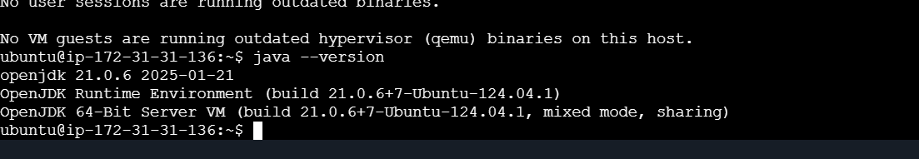
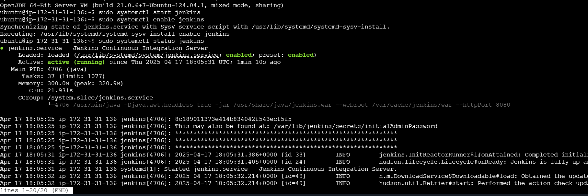
Jenkins
Jenkin installation
Os-ubuntu:
Step 1
Java installation
Jdk
Jenkin installation:
CMD
SUDO Systemctl Enable and Start the Jenkins :

Slide 3
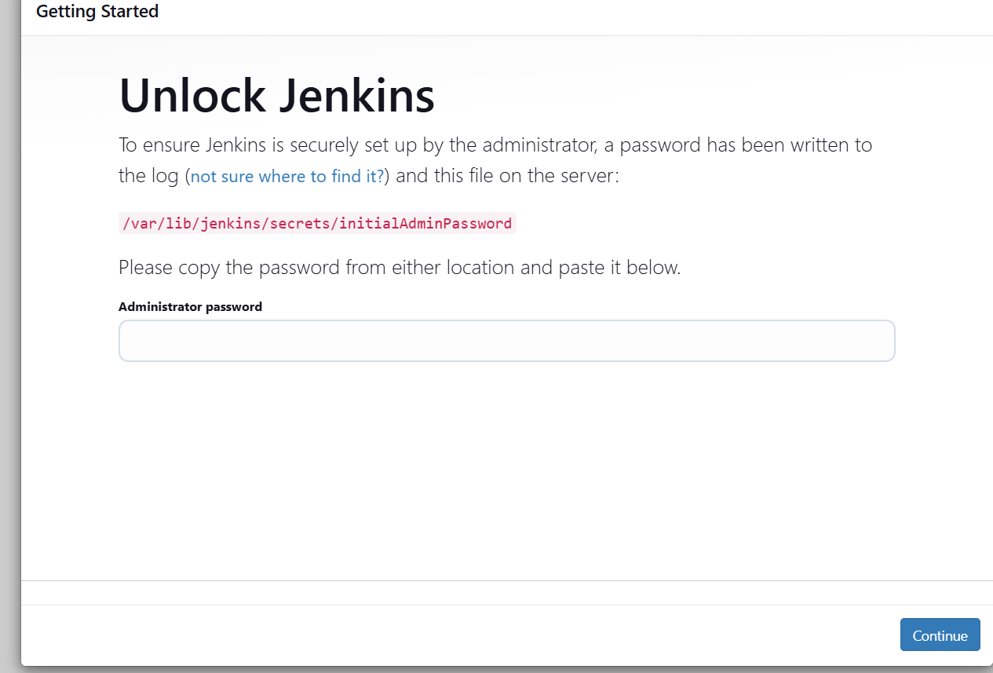
Step 2:
LOGIN JENKINS:
Go to browser put public ip address with 8080 port number default

Slide 4
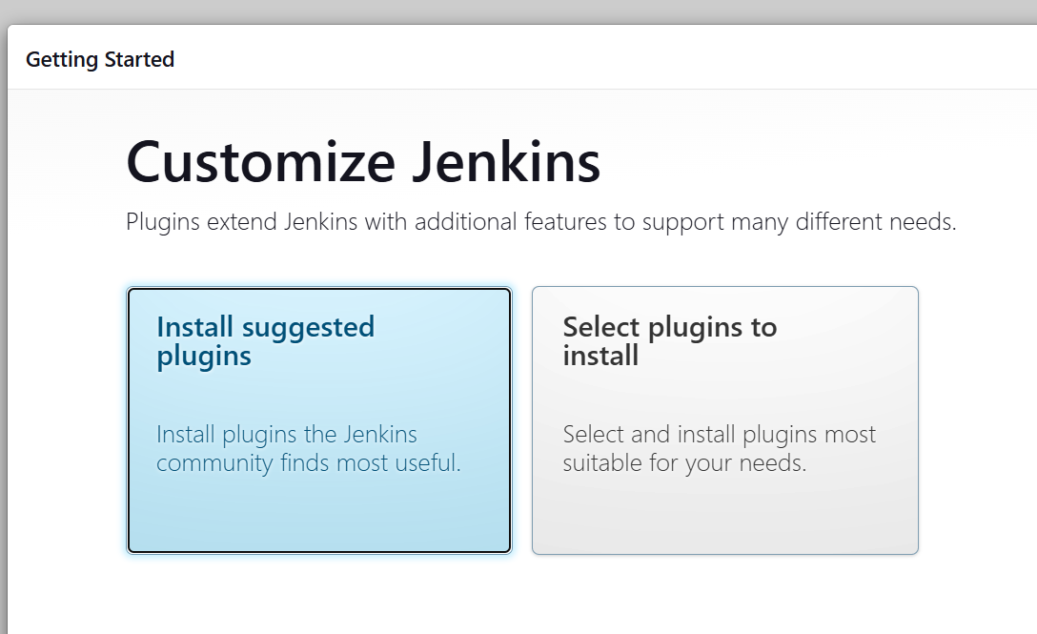
How to get the Administrator Password :
Copy the path go to machine using cat command to get the code
CMD SUDO CAT
Configuration
Set the username and password (own)
Plugin installations:

Slide 5
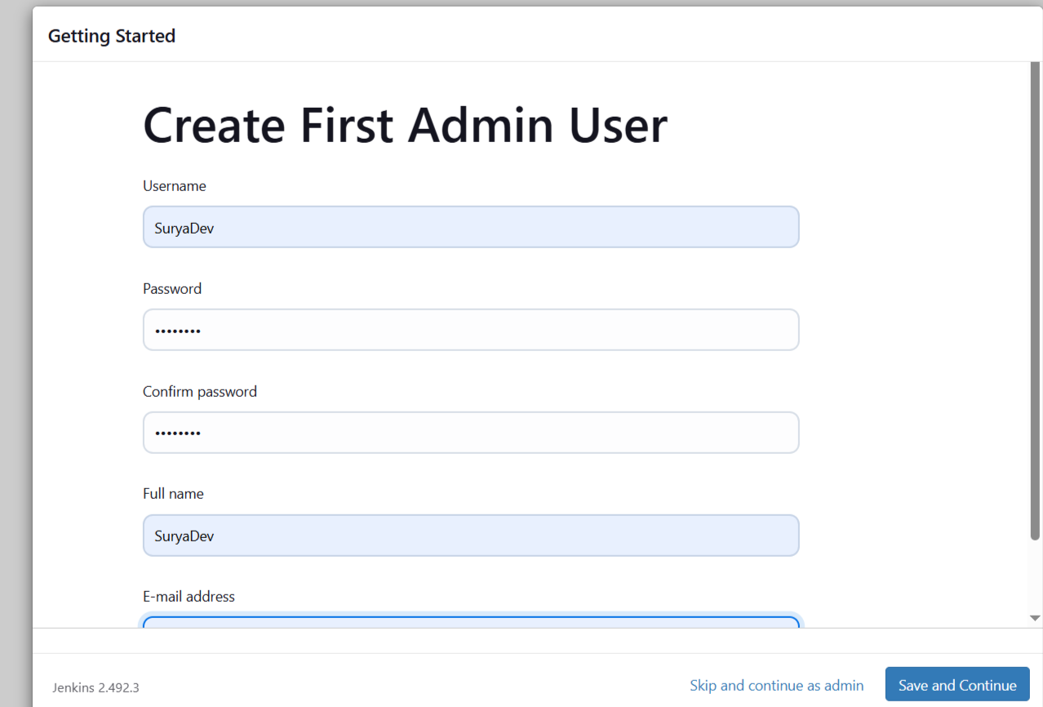
After completing the installation, you have to moved to set username and password
URL: http://youripadress:8080/
ready to use the jenkins
Finally get Jenkin job page:

Slide 6
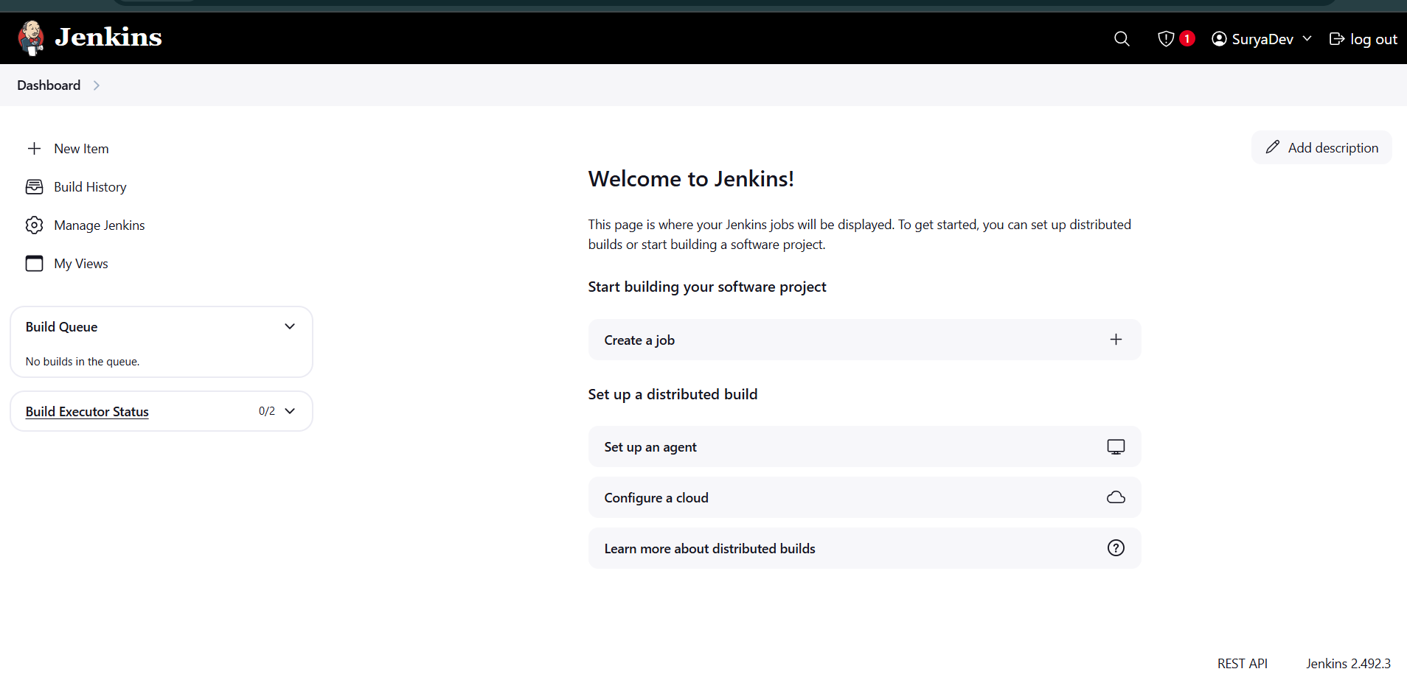
Global tools configuration: via Managejenkins

Slide 7
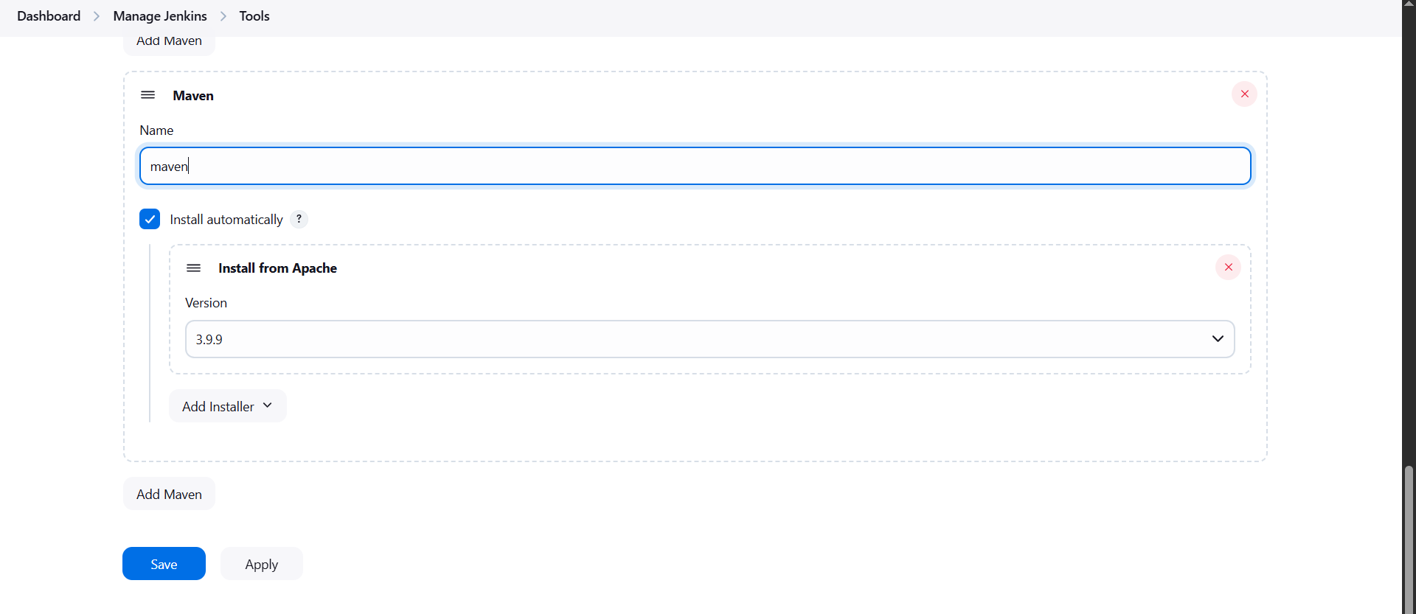
1.Maven tool
2.Git
3.jdk
Images

Slide 8
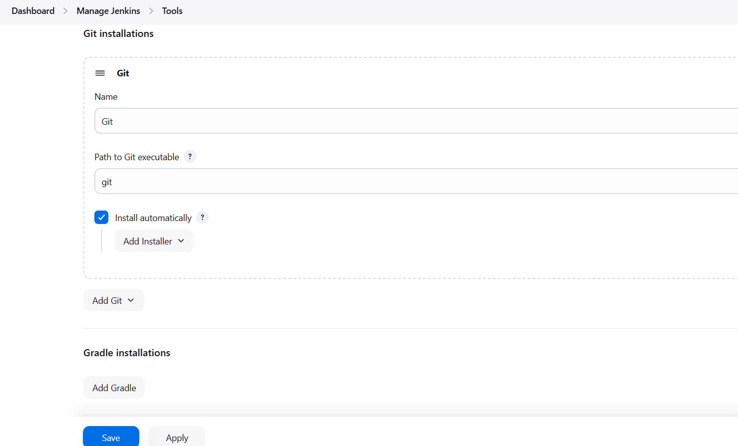

Slide 9
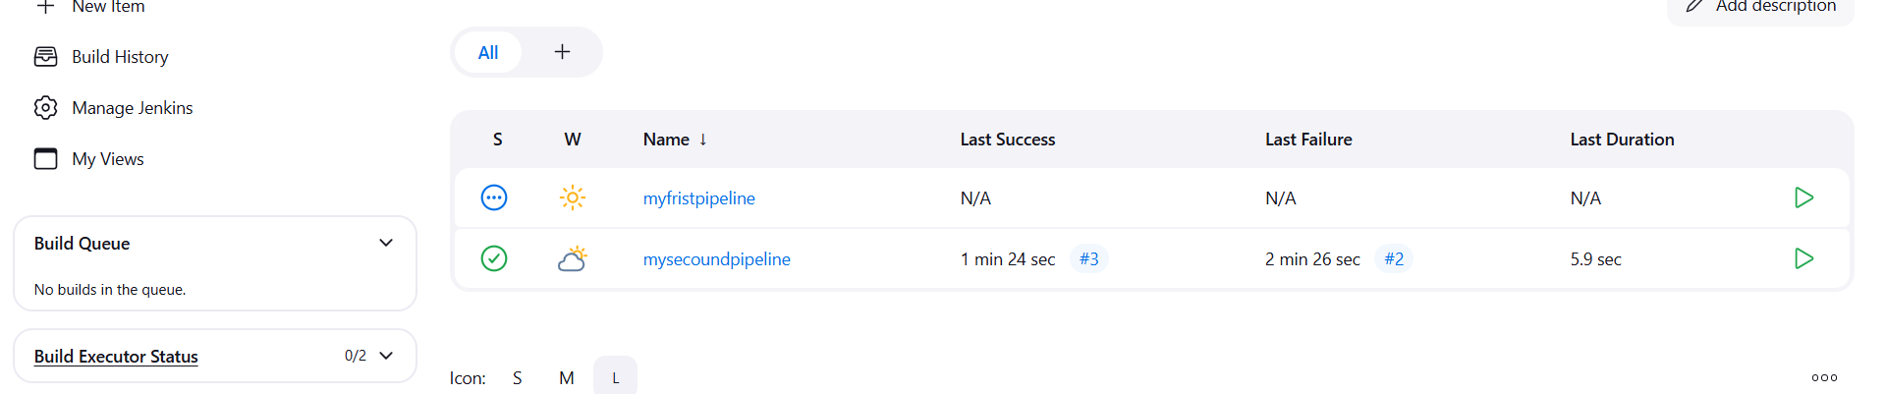
INSTALLATION AND CONFIGURATION COMPLETED
Project creation:
CI/CD PIPELINE
SCRIPTED TYPE
DECLARTIVE TYPE
i have to create the ci/cd pipeline project based on the below mentioned steps:
Got to Jenkins
DASHBOARD
name: mysecundpipeline
Select the which type of project: pipeline

Slide 10
Select the pipelinedeclarative project go to Configure
First i have to write the Description (project name) then got to pipeline
In the pipeline I add the Build steps ---- choose the mysecundpipeline
Write a code using Declarative pipeline syntax
code:
pipeline {
agent any
stages
{
stage('checkout')
{
steps
{
git 'https://github.com/jglick/simple-maven-project-with-tests.git‘ //repository url used to get a code
}

Slide 11
}
stage('build') {
steps {
echo 'buildjenkinsjob'
}
}
stage('test')
{
steps {
echo 'testjenkinsjob'
}
}
stage('deploy')
{
steps {
echo 'deployjenkinsjob'
}
}
}
}

Slide 12
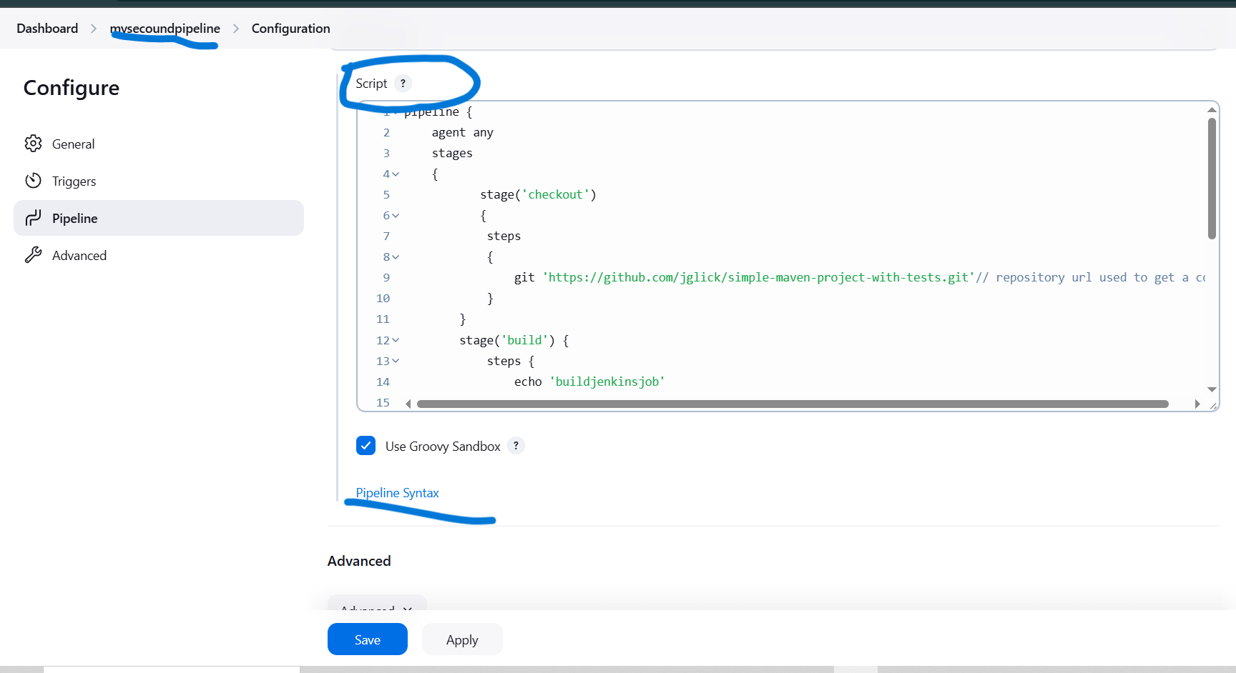
images
Apply and Save the configuration

Slide 13
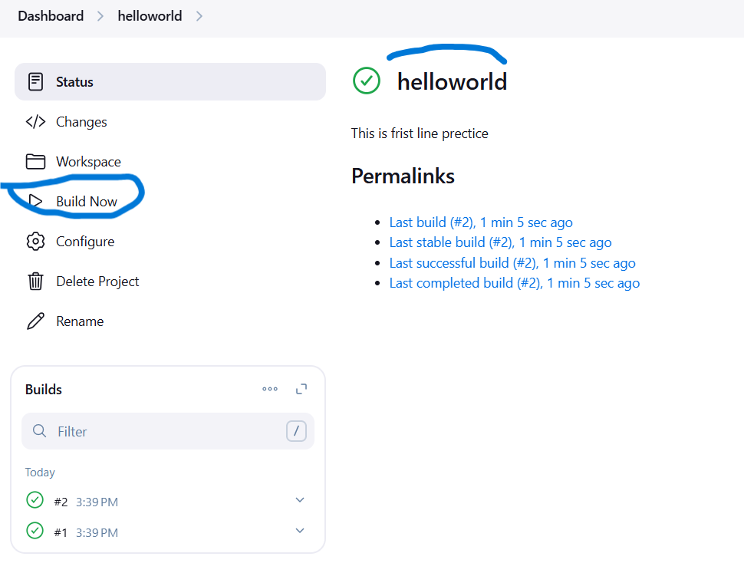
Build the Jenkins Job:
Run a job click the Build Now
This is take a time to run a program to execute the result
This is the build for pipeline job jenkins
Check the output:

Slide 14
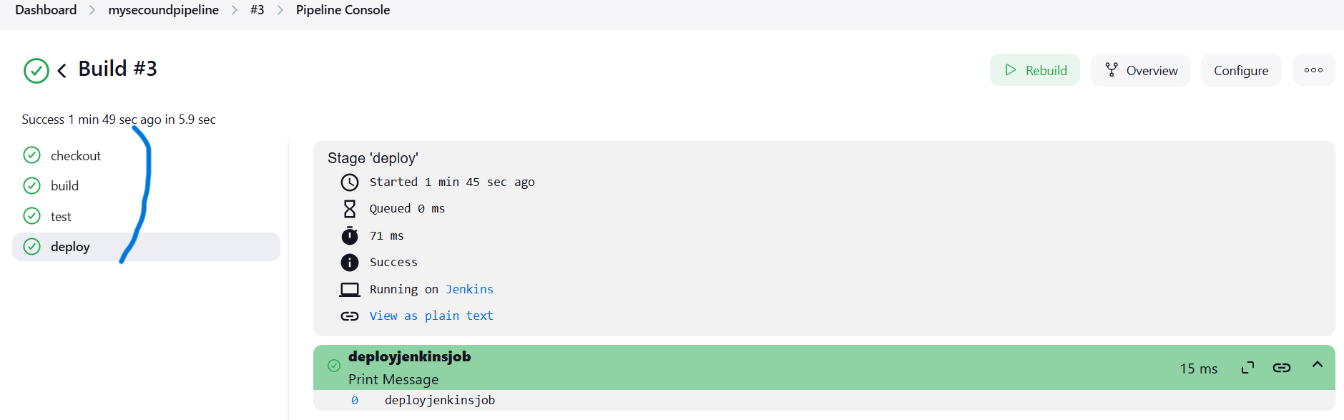
Finally get the build success for project
Project 2
Pipeline script with SCM: Declarative type
We have to follow the above steps upto pipeline then choose pipelinescript +scm
Steps :

Slide 15
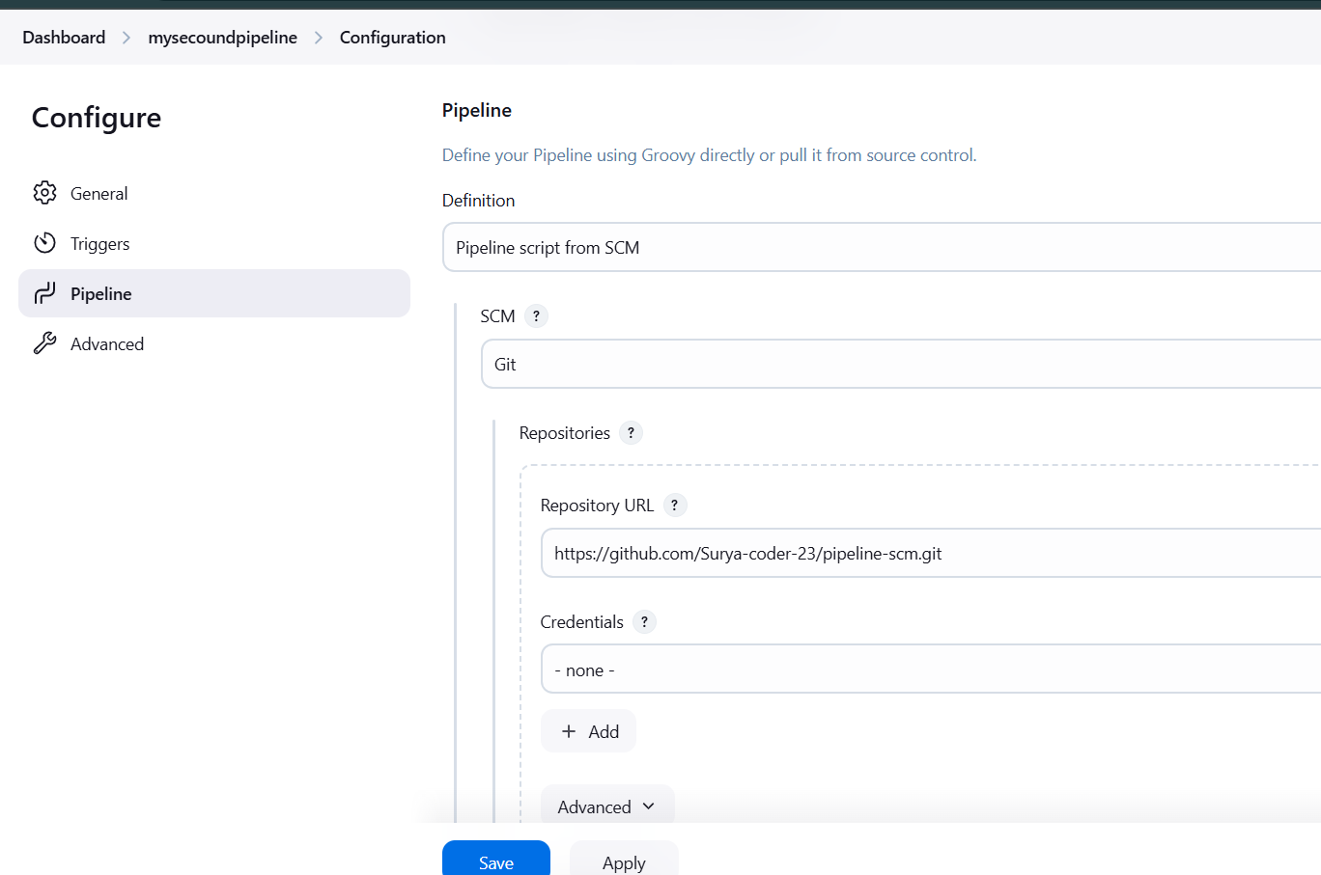
PATH
Path configuration don in the Adnvance : file name should be write “Jenkinfile”
Verify the Filename git hub repository

Slide 16
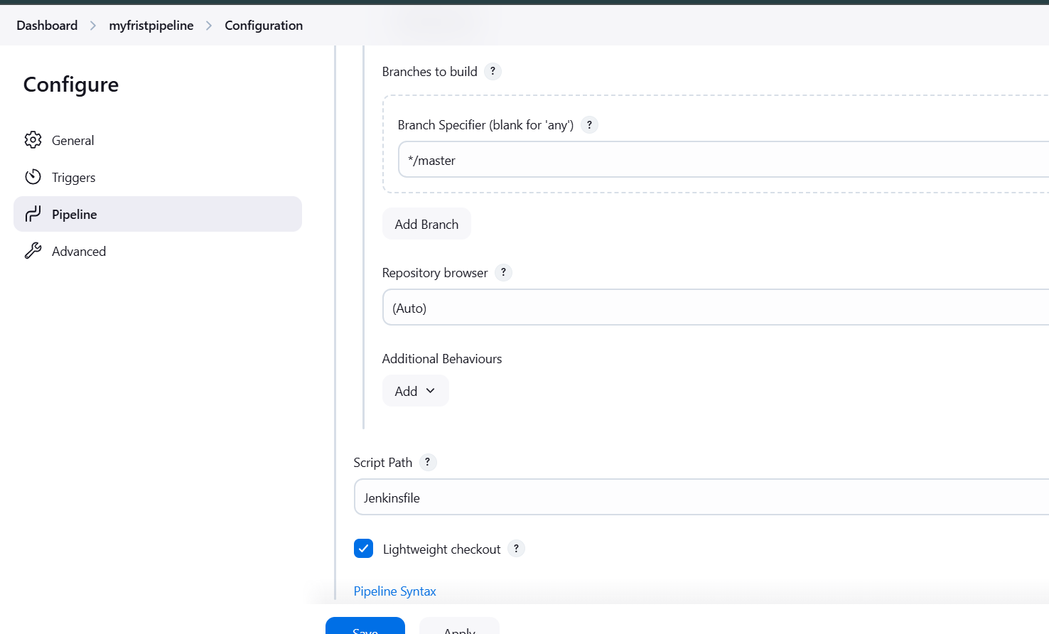
Github and jenkinfile creation:
Locally created Jenkinsfile without any extension (using any editor) inside the file write a code then finally moved or pushed into the GitHub Repository

Slide 17
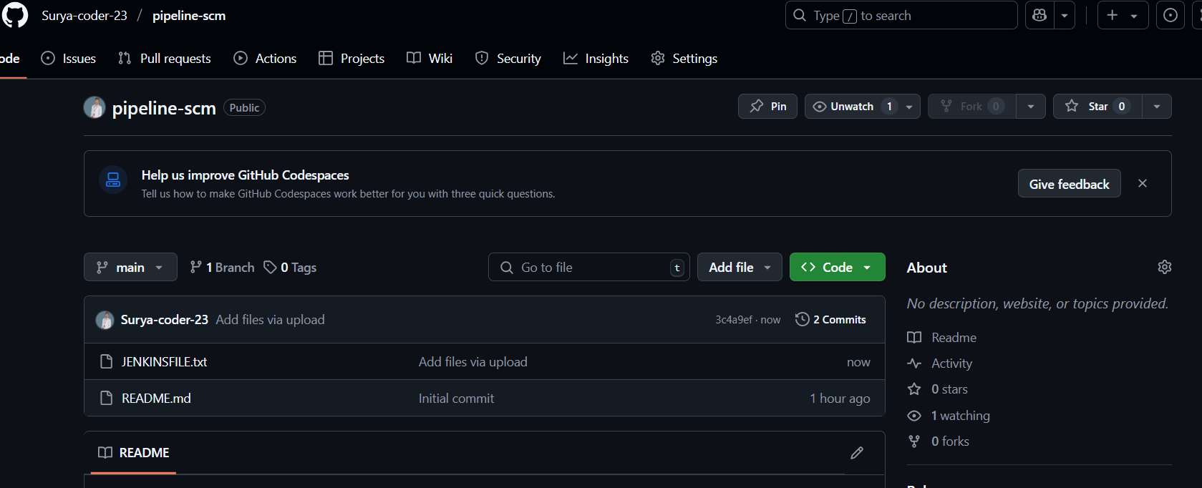
Code already written into the Jenkins file save it then push.
Code
write this script using Pipeline Syntax

Slide 18
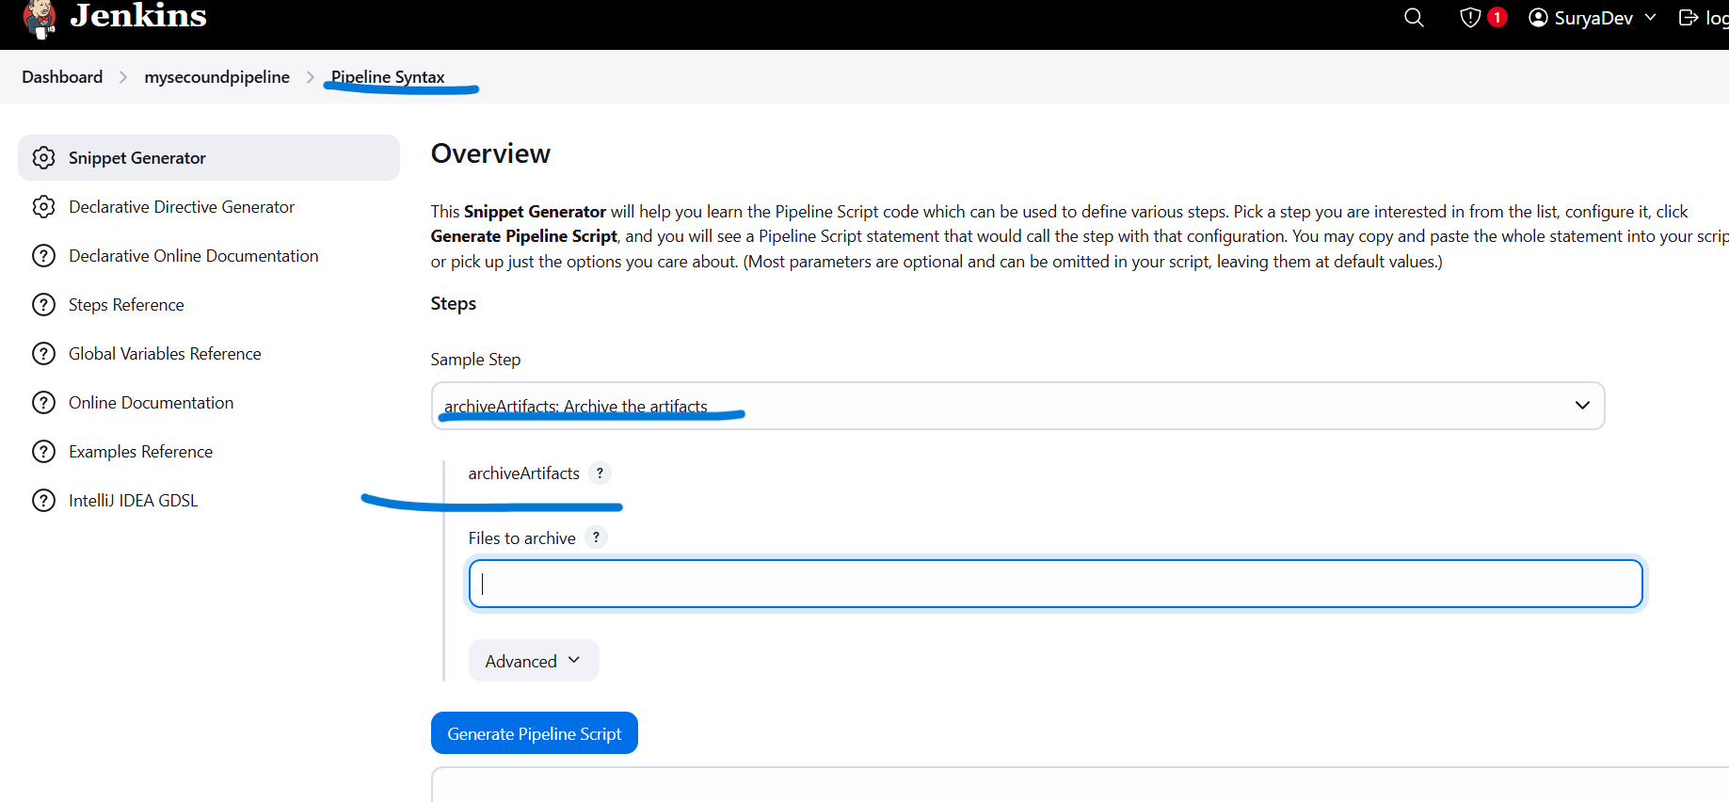

Slide 19
pipeline {
agent any
tools {
maven 'Maven' // Optional: remove if not using Maven
}
stages {
stage('Checkout') {
steps {
https://github.com/Surya-coder-23/pipeline-scm.git', branch: 'main' // clone the repository
}
}
stage('Build') {
steps {
sh 'mvn clean install'
}
}
stage('Test') {
steps {
sh 'mvn test'
}
}

Slide 20
stage('Package') {
steps {
sh 'mvn package'
}
}
}
post {
success {
echo 'Build completed successfully file created by SURYA .‘
}
failure {
echo 'Build failed!'
}
always {
junit '**/target/surefire-reports/*.xml'
archiveArtifacts '**/target/*.jar' // jar file configuration
}
}
}

Slide 21
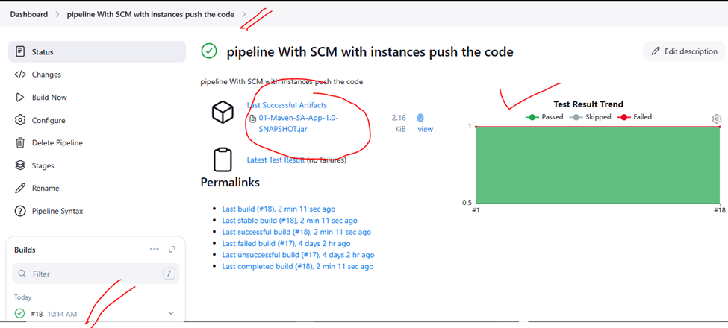
Save and Apply
Buildnow the Project

Slide 22
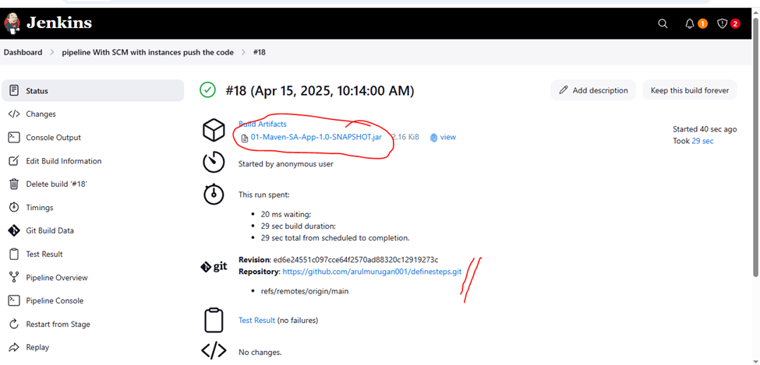
Output

Slide 23
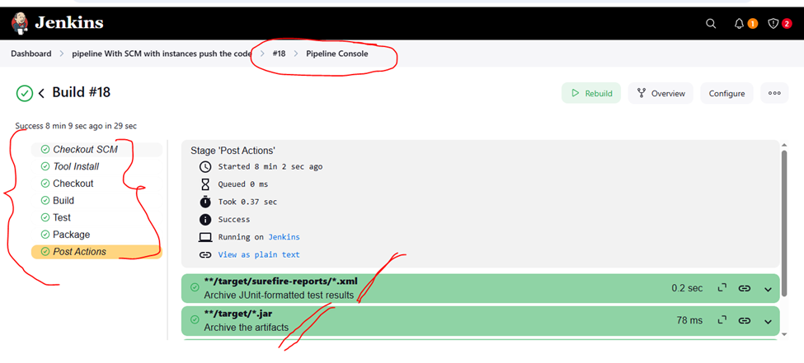
Pipeline Console View
Finally out put Pipeline

Slide 24
THE END

